Slide 1
HER2 Data Analysis Sensitivity/Resistant calls
Samuel Tsang, Aurora Blucher, Nate Evans
5/13/21

Slide 2
Agenda
Pharmacodynamics platform overview
HER2 project aim 1 overview
Experimental design + timeline
Data analysis
Sensitivity analysis

Slide 3
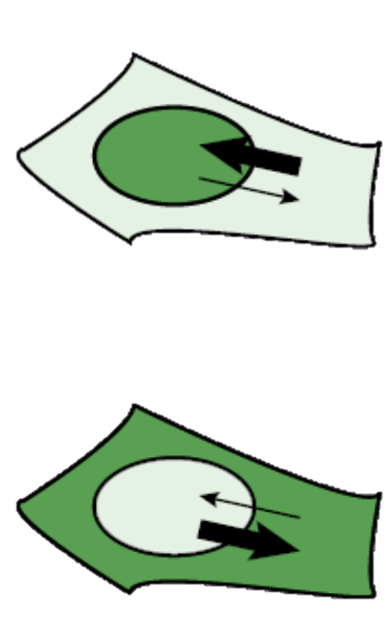
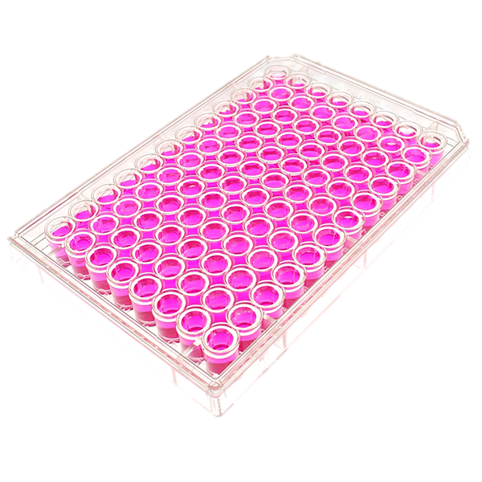
Pharmacodynamics imaging
Translocation reporter
Reporter 1
nucleus
Reporter 2
Active
Inactive
Notes:
I built this pharmacodynamics imaging system aiming to track drug response. This system has two key components – a collection of translocation reporters which shuffle between cytoplasm and nucleus based on drug activity, and a fully automated cell imaging system that can continuously scan the entire 96 well plate for days. Each well here contain a unique cell samples, they can be cells expressing different HER2 mutations or resistant gene drivers, or they can be cells under different treatments.
To facilitate data analysis, we also developed a customized algorithm to transform terabytes of images into analyzable figures for further interpretation.

Slide 4
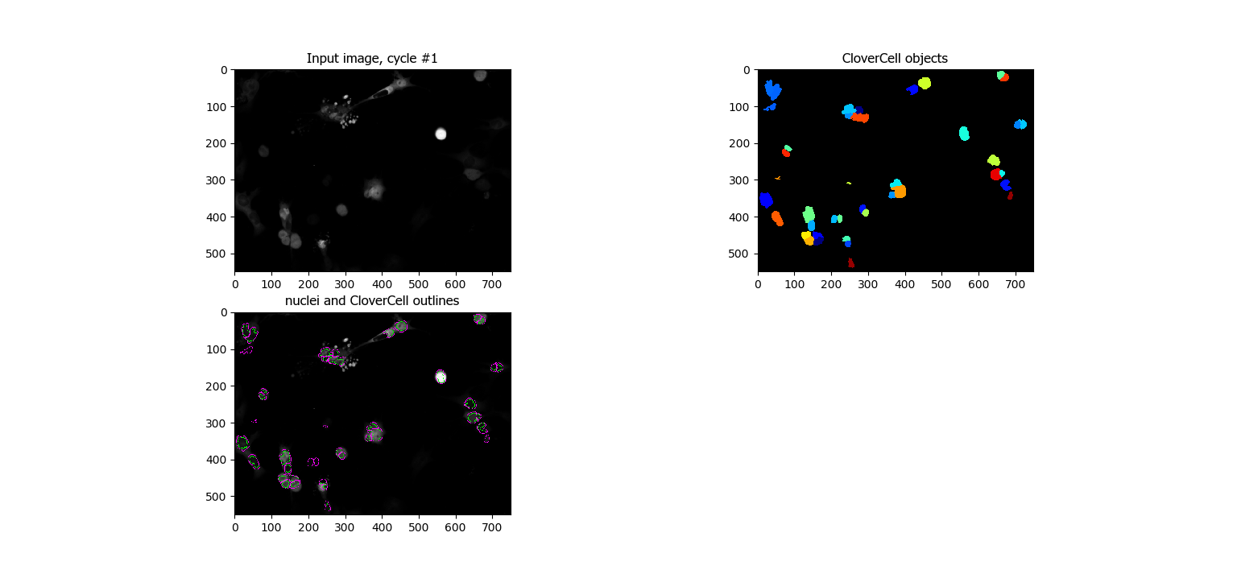
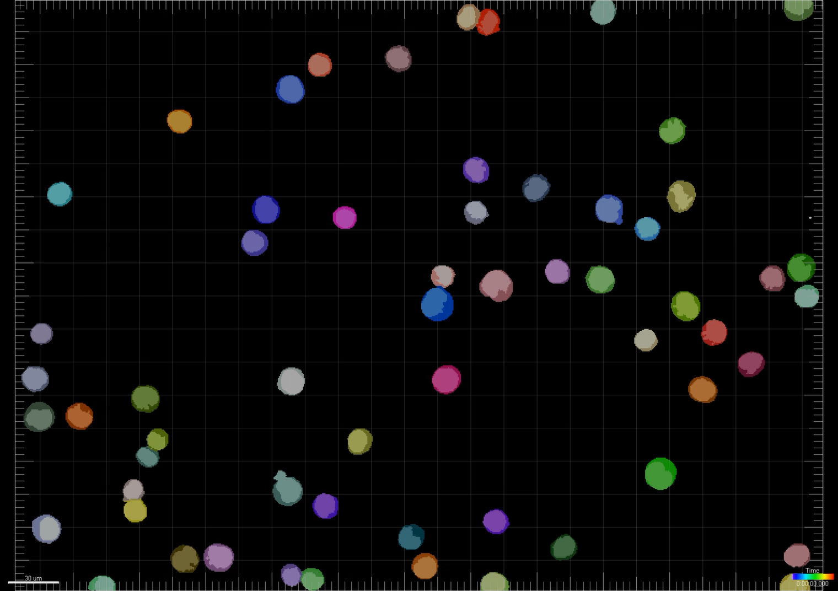
Image analysis pipeline
ilastik
Cell Profiler
FIJI ImageJ
Imaris
Nucleus classification
(machine learning)
Cytoplasm classification
(dilation with fixed pixel)
Reconstruct hypserstacks with metadata
Cell tracking & data export
Notes:
I built this pharmacodynamics imaging system aiming to track drug response. This system has two key components – a collection of translocation reporters which shuffle between cytoplasm and nucleus based on drug activity, and a fully automated cell imaging system that can continuously scan the entire 96 well plate for days. Each well here contain a unique cell samples, they can be cells expressing different HER2 mutations or resistant gene drivers, or they can be cells under different treatments.
To facilitate data analysis, we also developed a customized algorithm to transform terabytes of images into analyzable figures for further interpretation.

Slide 5
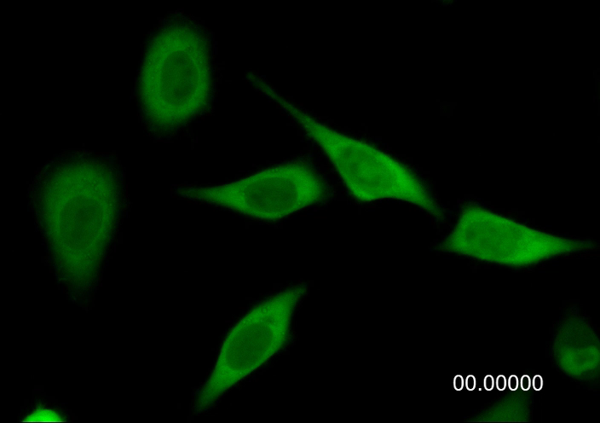
How to quantify reporter activity?
R$eporter Activity \left(RA\right)=\frac{{Mean intensity}_{compartment (active)}}{{Mean intensity}_{compartment (inactive)}}$
$$Reporter Activity Score=\frac{Reporter Activity t−Reporter Activity min}{Reporter Activity\max{− Reporter Activity min}}$$
Notes:
I built this pharmacodynamics imaging system aiming to track drug response. This system has two key components – a collection of translocation reporters which shuffle between cytoplasm and nucleus based on drug activity, and a fully automated cell imaging system that can continuously scan the entire 96 well plate for days. Each well here contain a unique cell samples, they can be cells expressing different HER2 mutations or resistant gene drivers, or they can be cells under different treatments.
To facilitate data analysis, we also developed a customized algorithm to transform terabytes of images into analyzable figures for further interpretation.

Slide 6
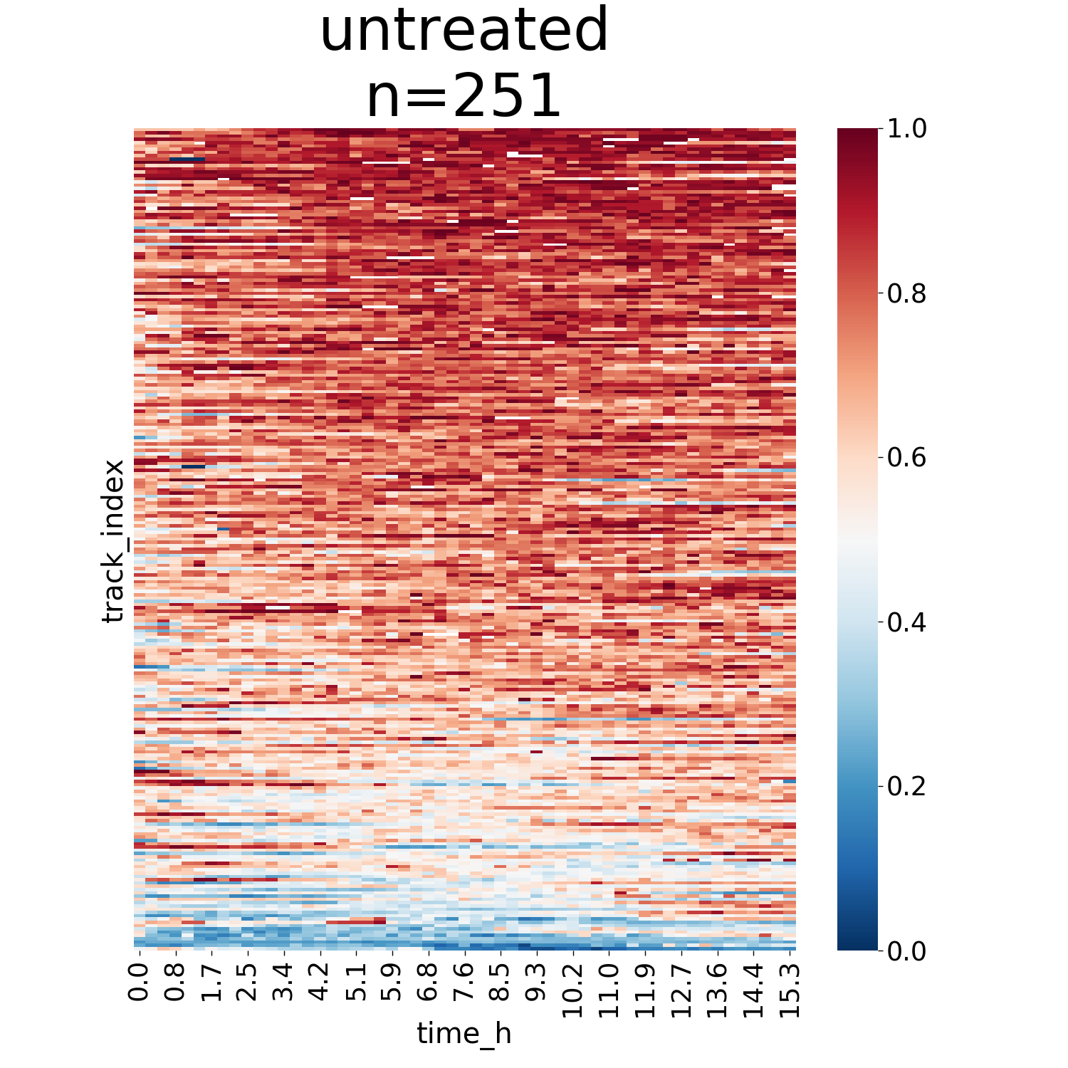
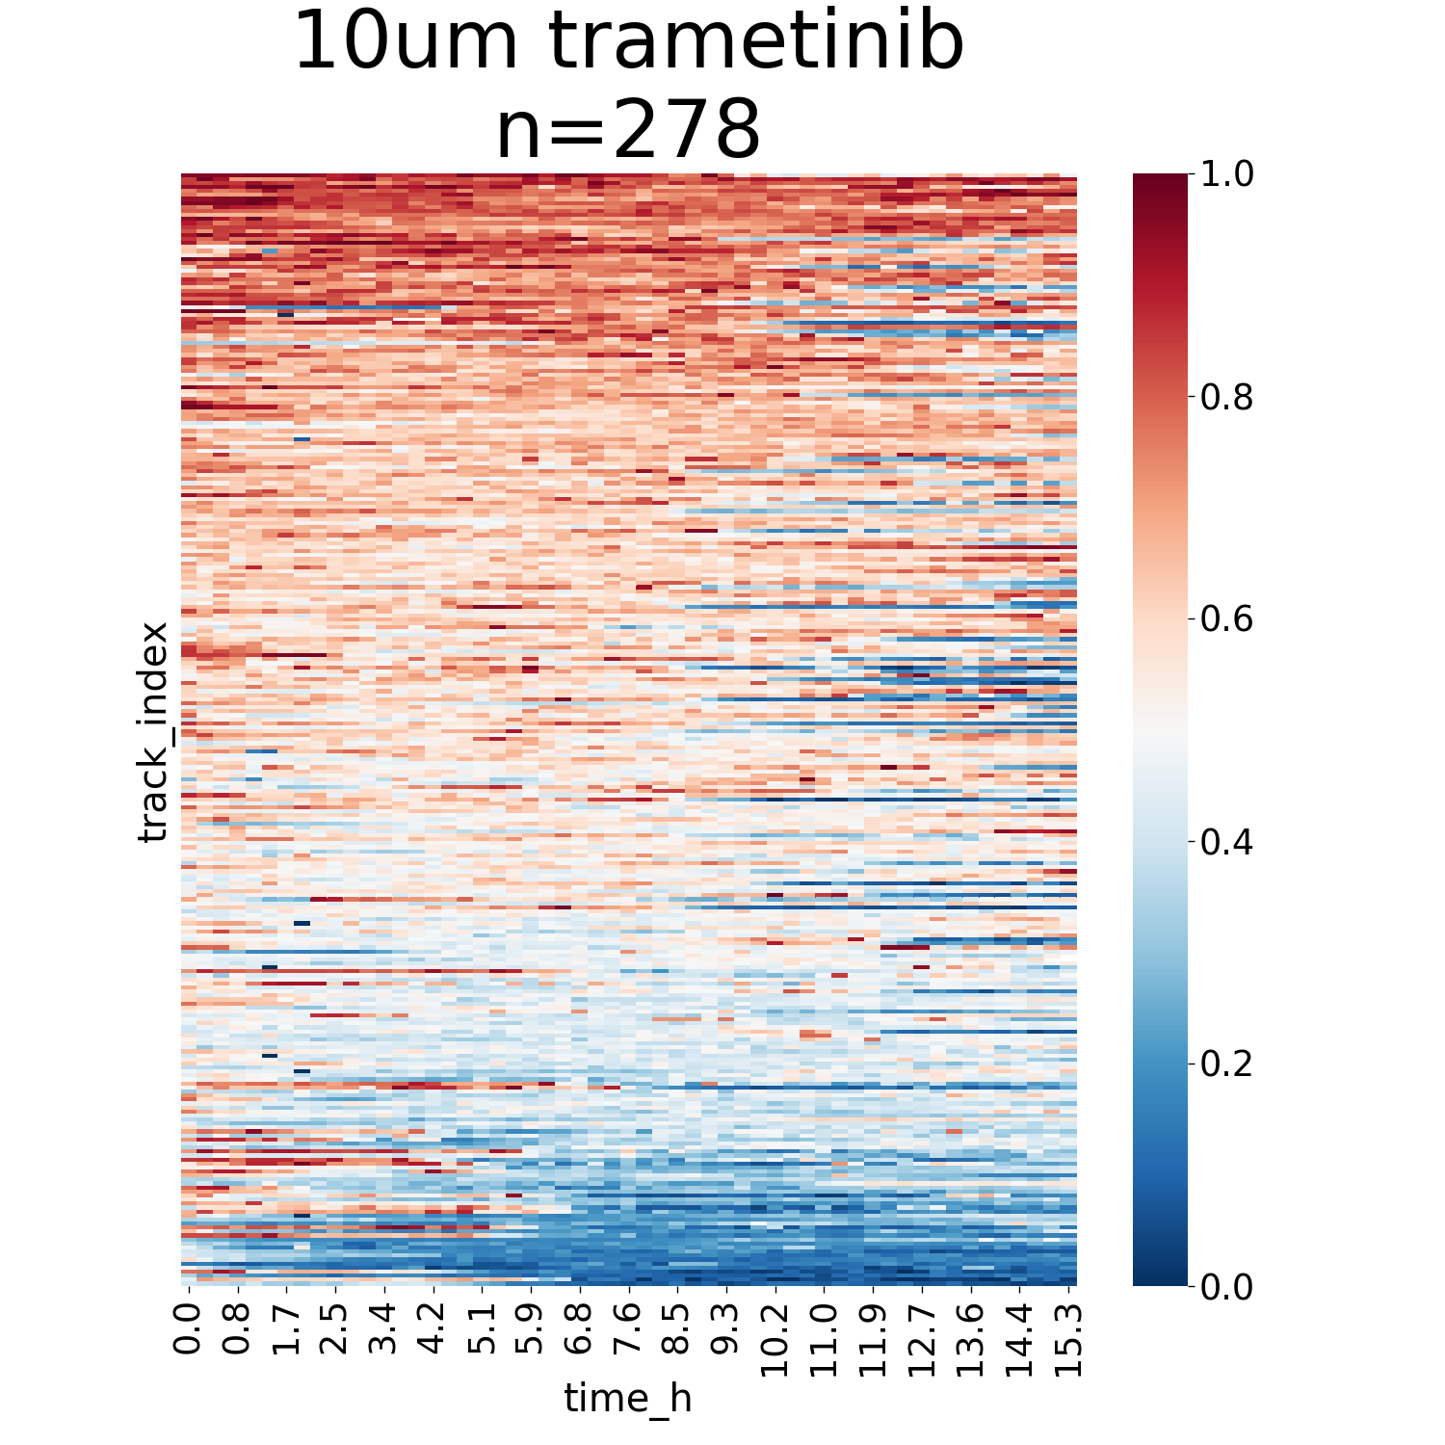
Imaging analysis pipeline
1. CombineTools_abs
Single cell
Average
Notes:
I built this pharmacodynamics imaging system aiming to track drug response. This system has two key components – a collection of translocation reporters which shuffle between cytoplasm and nucleus based on drug activity, and a fully automated cell imaging system that can continuously scan the entire 96 well plate for days. Each well here contain a unique cell samples, they can be cells expressing different HER2 mutations or resistant gene drivers, or they can be cells under different treatments.
To facilitate data analysis, we also developed a customized algorithm to transform terabytes of images into analyzable figures for further interpretation.

Slide 7
HER2 targeted therapy has NOT reached its full potential
OPPORTUNITIES:
Goal #1 -- identify more patients who can benefit from HER2 inhibition
Goal #2 – stop tumors from coming back by targeting the drug resistance mechanism
Notes:
Second goal of this study is to reduce the high relapse rates of HER2 positive breast cancer by addressing the therapeutic resistance from HER2 targeted therapy.

Slide 8
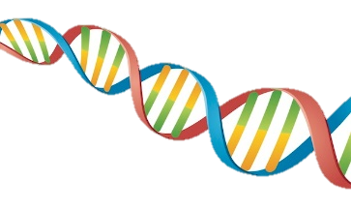
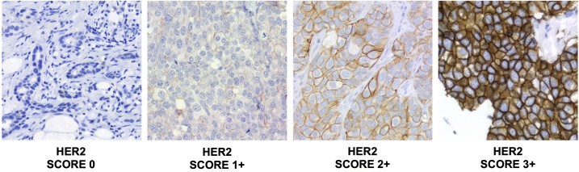
Which patient can receive HER2 targeted therapy?
DNA
Protein
HER2 negative
HER2 positive
Spectrum of HER2 low

Slide 9
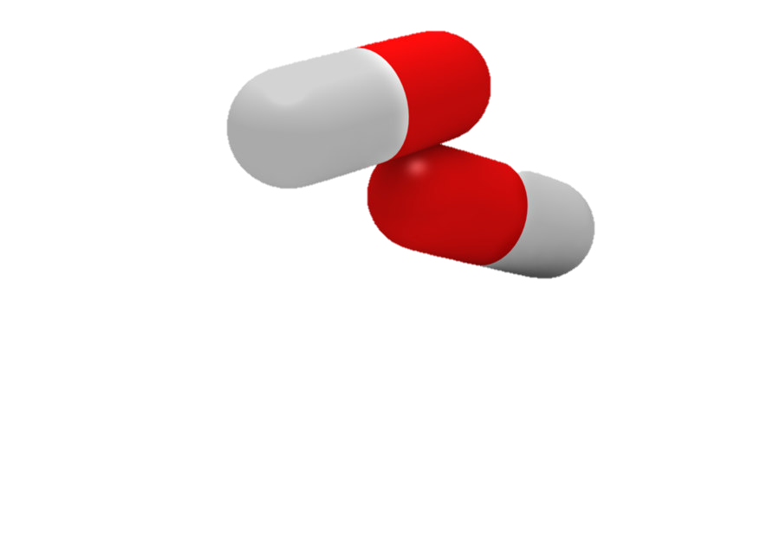
HER2 mutation is NOT qualified for HER2 targeted therapy
Normal cell
HER2 mutated cell
?
HER2
HER2*

Slide 10
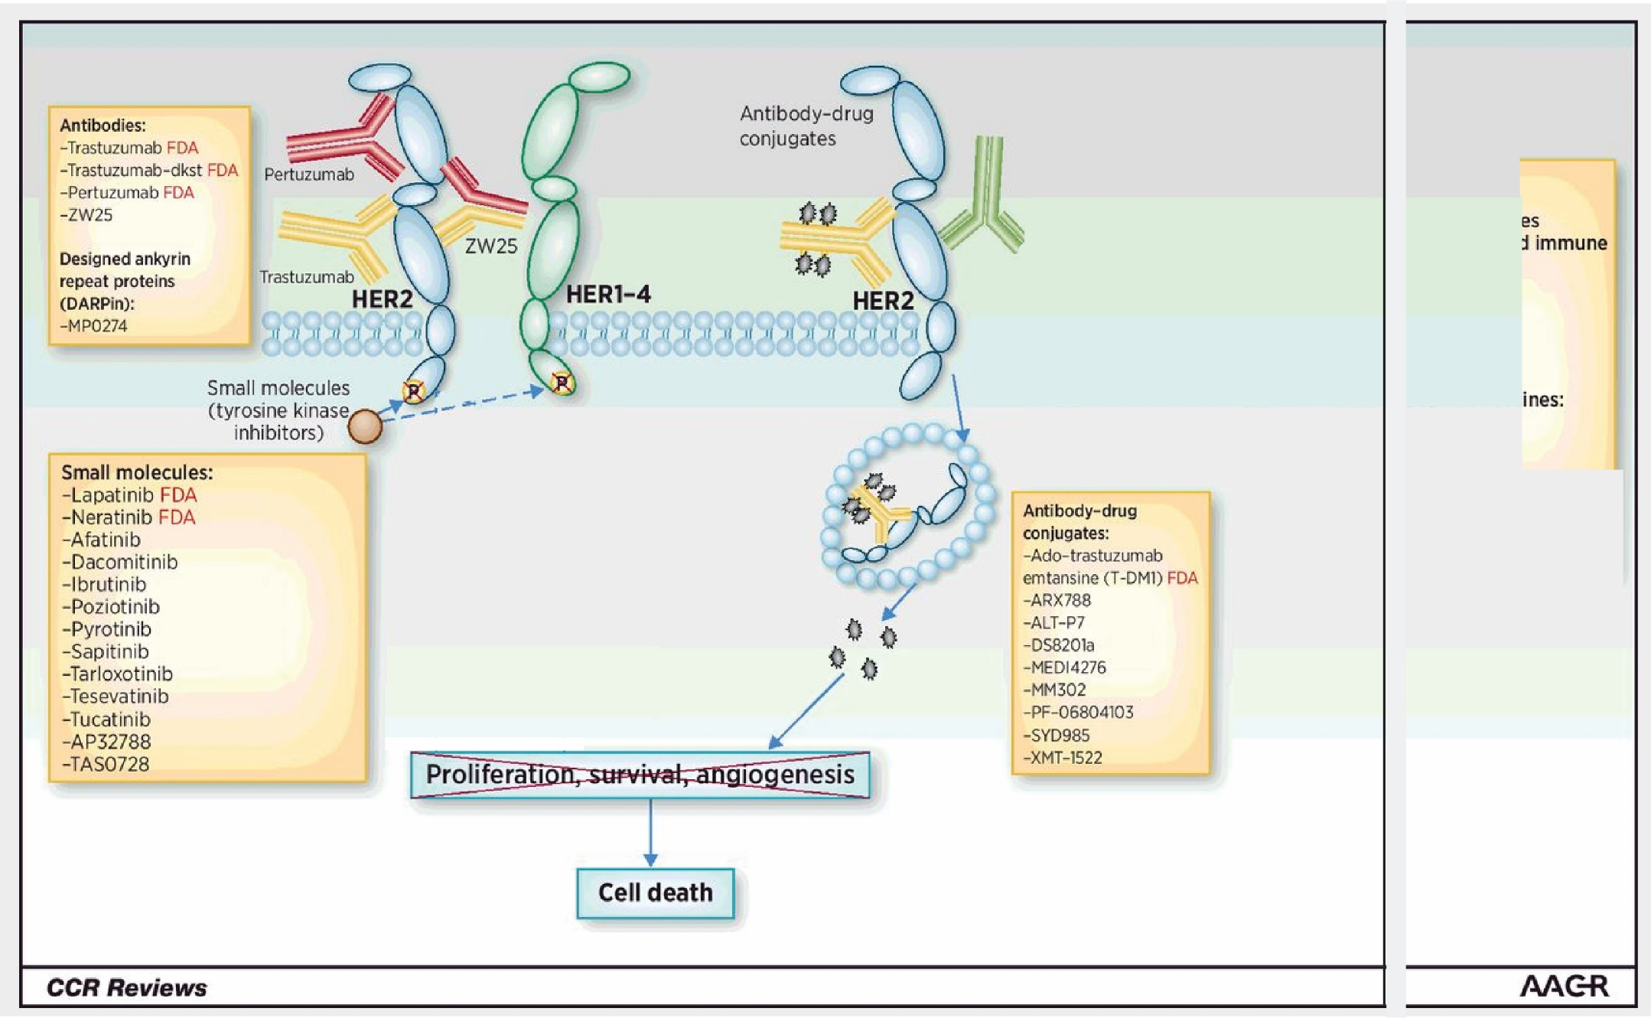
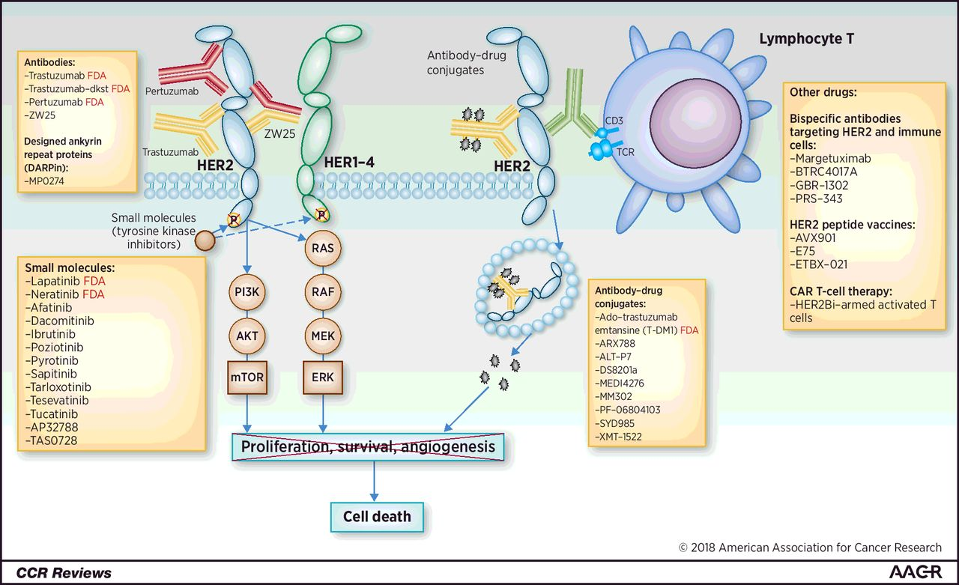

We need to match HER2 mutation with the BEST drug
Notes:
These mutations could also be the third marker to select patients for HER2 targeted therapy.
It takes months and more than a thousand dollars to synthesize a single mutant clone, which is why we only studied so few of them.
Our lab has an unique advantage to conduct this type of large scale genetic studies because I developed a high-throughput cloning platform that allows us to make all the 130ish mutations in a month with less than 1/10 of the cost. I am going to talk more about this platform in the later part of the presentation.

Slide 11
Methods
Mutation data for 6,664 breast cancer patient samples were downloaded from cBioPortal (1,2) across a total of 13 breast cancer studies (3–15). At the time of download, the public cBioPortal used the hg19/GRCh37 version of the reference genome. Mutations in cBioPortal are assumed to be on the (+) strand unless otherwise noted by dataset depositors.
A total of 97 ERBB2 alterations across 222 samples were collected, including single nucleotide polymorphisms and small insertions and deletions. We required SNPs to be missense or splice-site and included both frame- shift and in-frame alterations.

Slide 12
cBioPotal
Identify Common HER2 mutations (breast)
Assign sensitivity based on similarity to controls
Induce Mutations
Live cell reporter imaging
SKBR8
Validation
SKBR3 is HER2+
EFM192A
Growth/Death Assays
Live cell reporter imaging (MCF10A, HER2-)
EFM192A is ER+/HER2+

Slide 13
Aim1 Timeline
Jan 2021
Now
JULY
SEPT
SKBR3 Imaging
SKBR3 processing
Validation
EFM192A Imaging
EFM192A processing

Slide 14
Data Analysis Overview
Project Goal: Match HER2 mutations to effective targeted therapies.
Experiment Summary: For the SKBR3, EFM192A cell line:
(Test control cell lines (see below) with each mutant)
1) induce a specific HER2 mutation
2) The functional response to a Neratinib and Trastuzumab is measured by live cell reporter imaging
(pathway activity time series).
Controls:
WT SKB cells: These cells are sensitive to both Neratinib and Trastuzumab.
T798I cells: These cells are resistant to neratinib and has an unknown response to Trastuzumab
Nd611 cells: Resistant driver in-vivo – but may not show resistance in-vitro … maybe resistant to Trastuzumab.
The goal of this analysis is to explore how to assign mutant HER2 cell lines resistance/sensitivity calls.
(The data presented was done with ½ of the SKBR3 dataset)

Slide 15
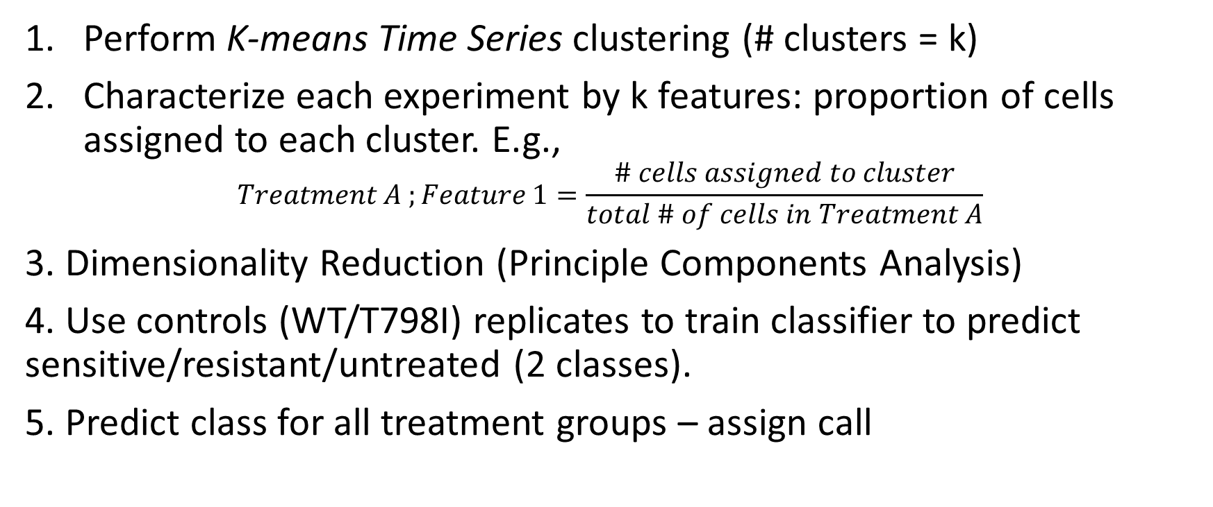
Data analysis overview
Perform K-means Time Series clustering (# clusters = k)
Characterize each experiment by k features: proportion of cells assigned to each cluster. E.g.,
$$Treatment A ;Feature 1=\frac{\# cells assigned to cluster}{total \# of cells in Treatment A}$$
3. Dimensionality Reduction (Principle Components Analysis)
4. Use controls (WT/T798I) replicates to train classifier to predict sensitive/resistant/untreated (2 classes).
5. Predict class for all treatment groups – assign call

Slide 16
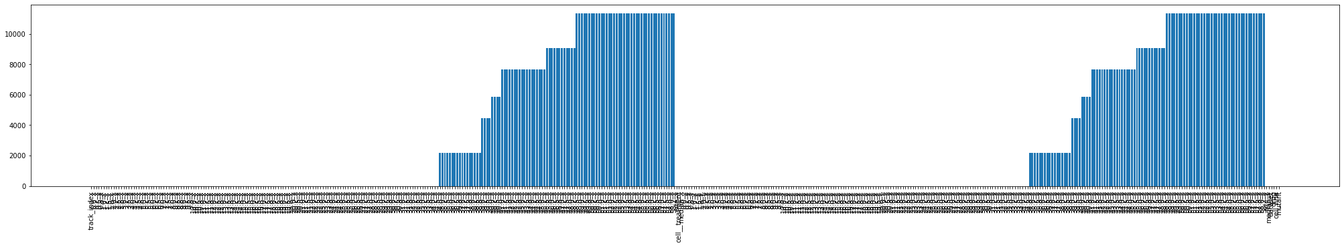
Data Pre-Processing, QC, Filtering
Using normalized data
Excluded time that has missing features across all treatment groups
Why is the data missing? Data is run for different lengths depending on when it is collected by Samuel – arbitrary differences
Resampled time-series to length = 100
Clover time series 0-58 hours
Mscarlet time series 0-58 hours
# NAs

Slide 17
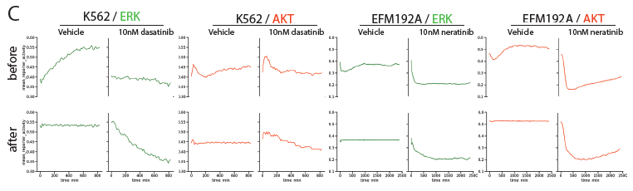
Data Normalization

Slide 18
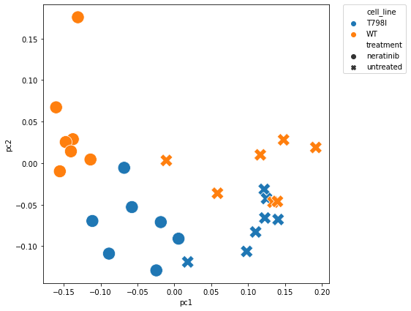
Batch Effects [To-Do]
Use untreated controls, assume normal distribution- fit params and identify outliers by likelihood below some threshold
Untreated

Slide 19
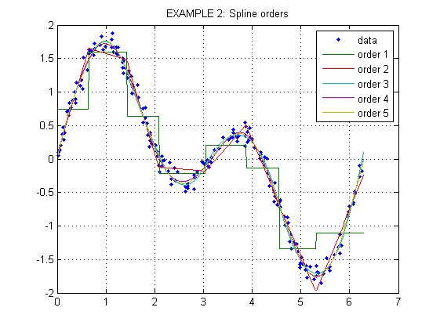
Tslearn TimeSeriesResampler
Uses scipy.interp1d
Type: “slinear” (spline of order 1)
Interpolation tutorial

Slide 20
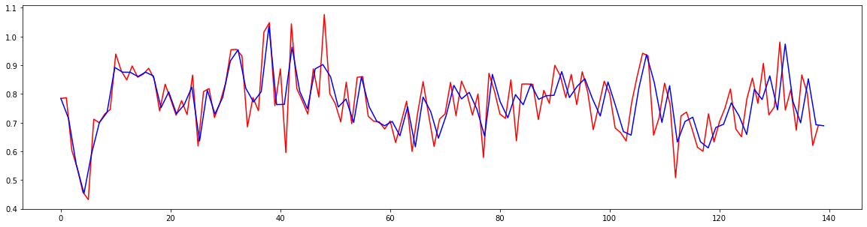
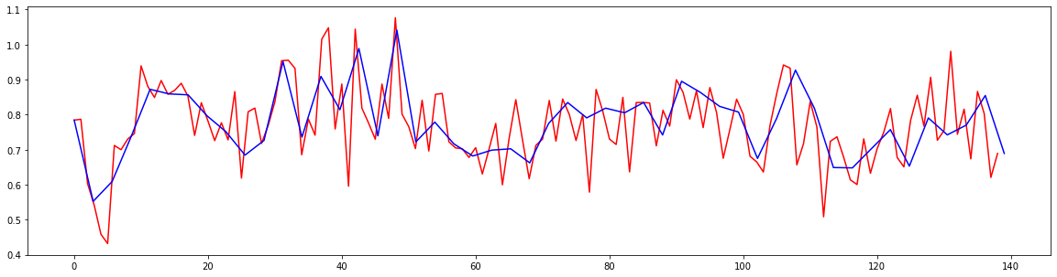
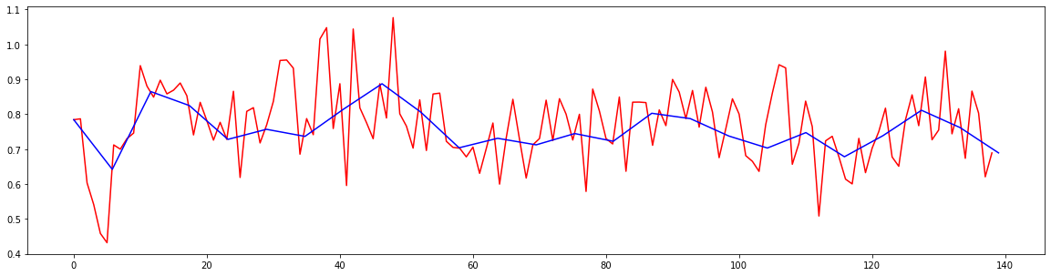
Resampling Example
Sz = 100
Sz = 50
Sz = 25

Slide 21
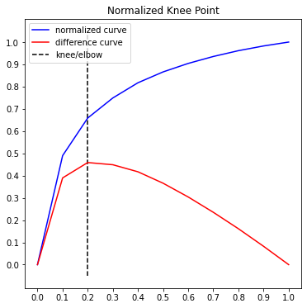
K-Means Time Series Clustering
Tslearn Package: https://tslearn.readthedocs.io/en/stable/index.html
Distance metric: Euclidean [options: DTW, DTW-soft, KernelKmeans]
Elbow plot suggests knee at around 4 – HOWEVER – experimentation shows better separation with greater # clusters:
Used K (# clusters) = 25

Slide 22
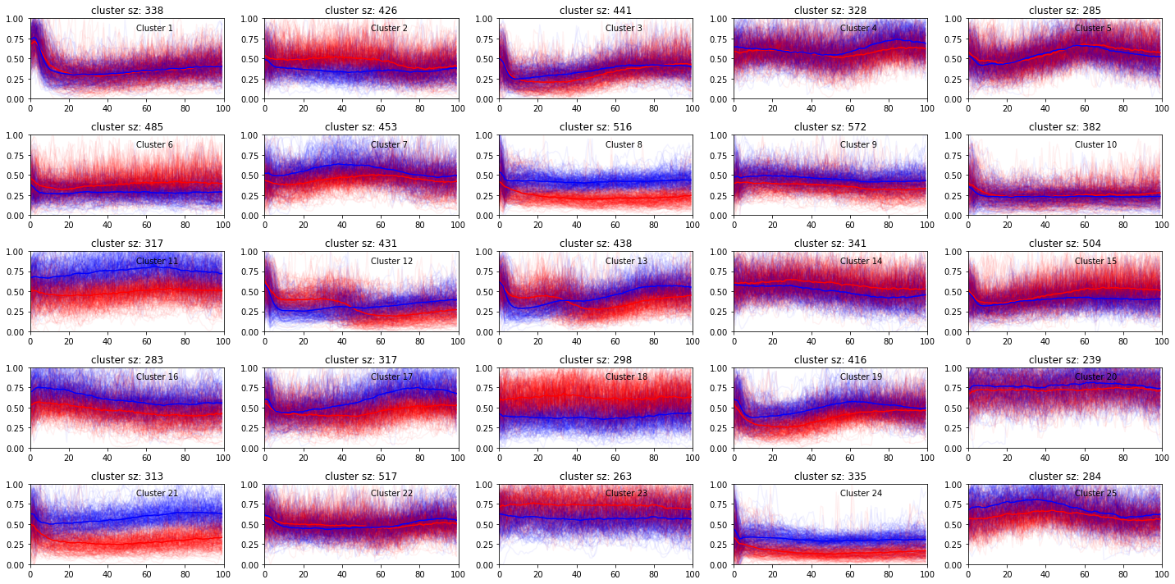

Slide 23
Experiment cluster proportion
2. Quantify cluster proportion within experiment
1. Assign clusters
Cluster 1
Cluster 1 = 0.67
Cluster 1
Cluster 2 = 0.33
Cluster 2

Slide 24
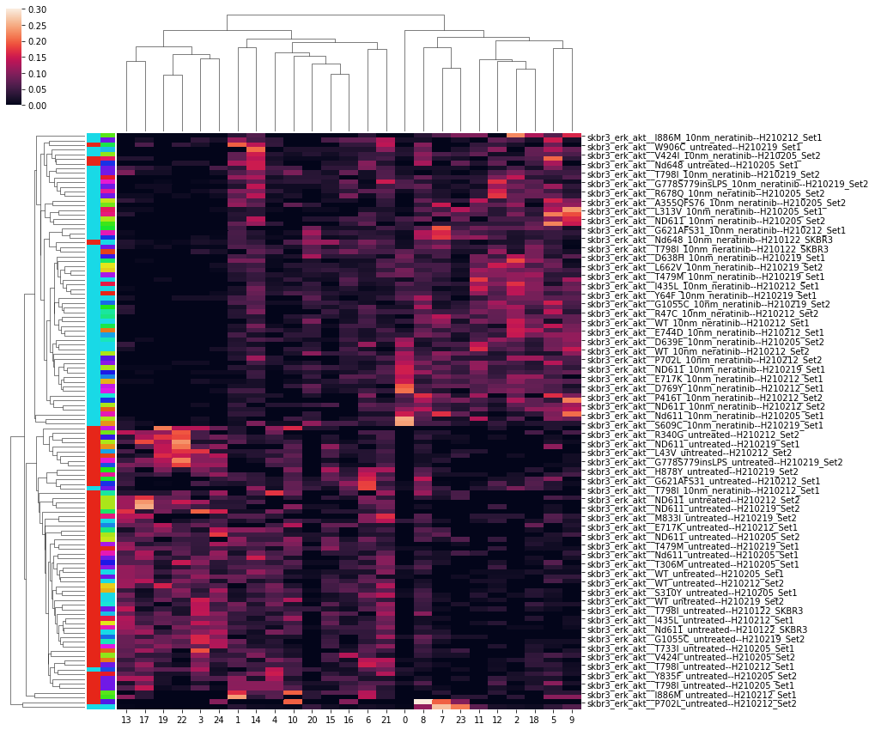
Cluster Proportion Heatmap
Treatment (Drug/untreated)
Mutant
Neratinib and untreated
All cell lines

Slide 25
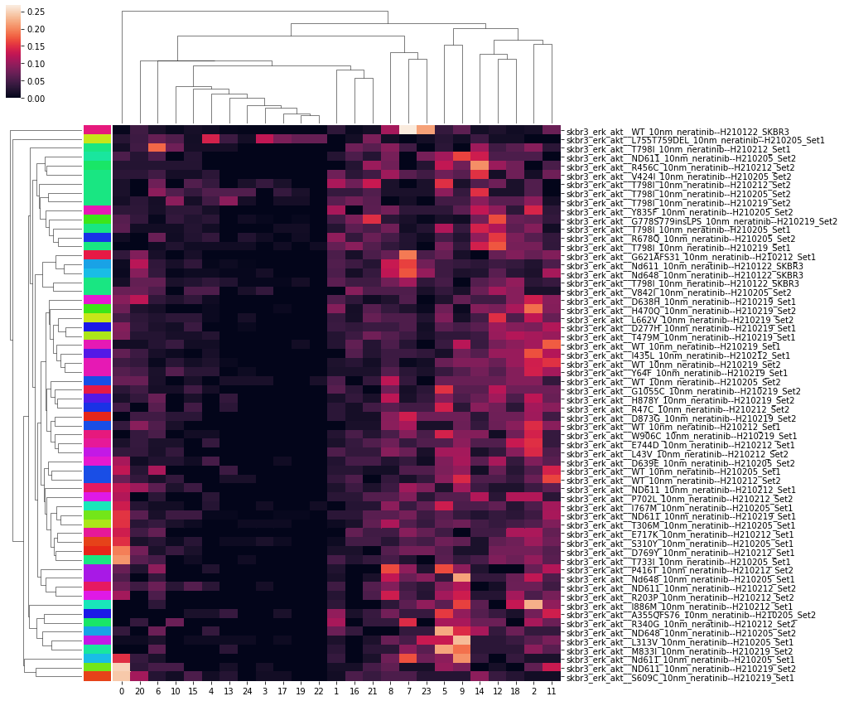
Cluster proportion heatmap (neratinib only)

Slide 26
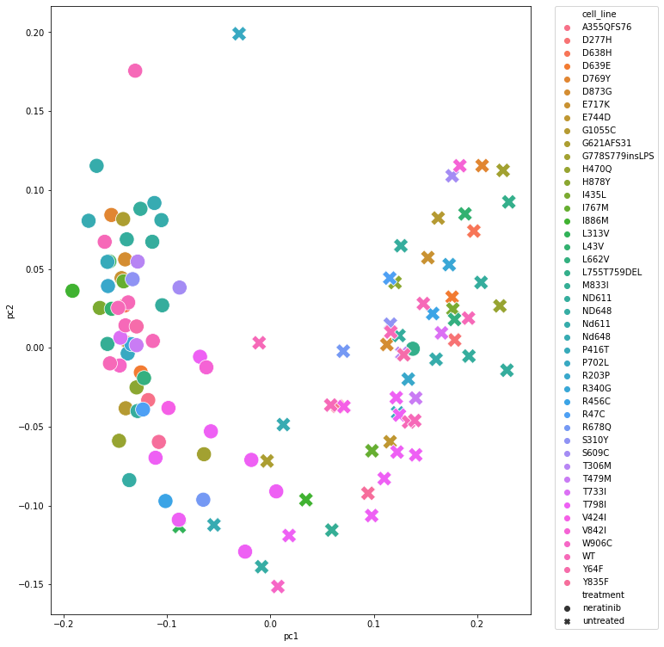
Dimensionality Reduction (PCA)
All Treatment Groups
explained variance ratio: [0.38 0.09]
Controls Only
Sensitive
Untreated
Resistant

Slide 27
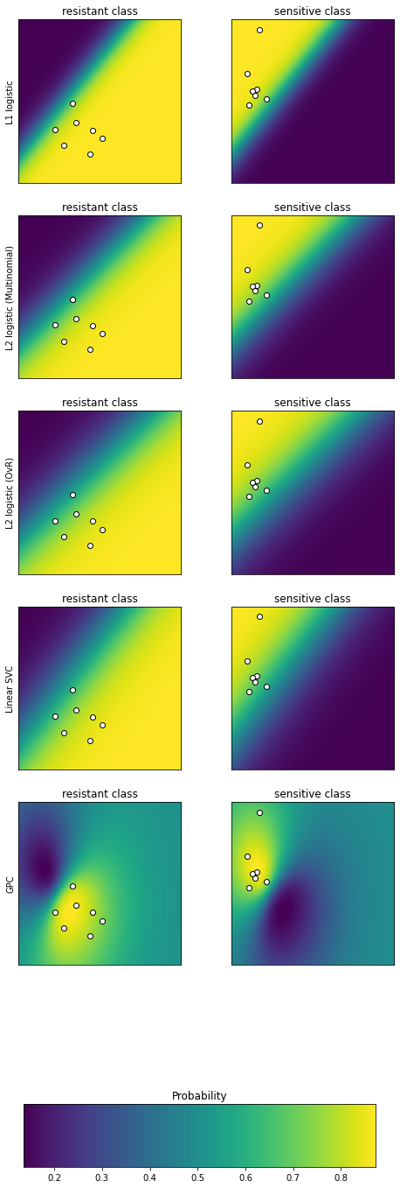
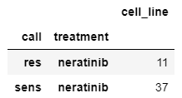
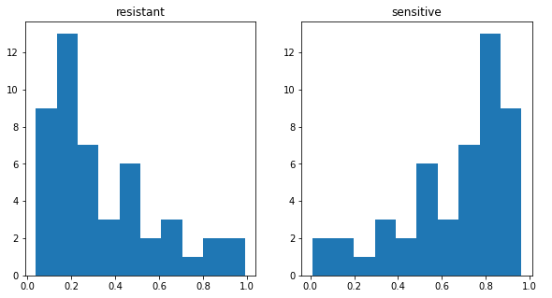
Sens/Res Classifier
Trained classifier on just neratinib (T798I=0 (res), WT=1 (sens))
Predicted classes on remaining neratinib samples (excluding WT, T798I)

Slide 28
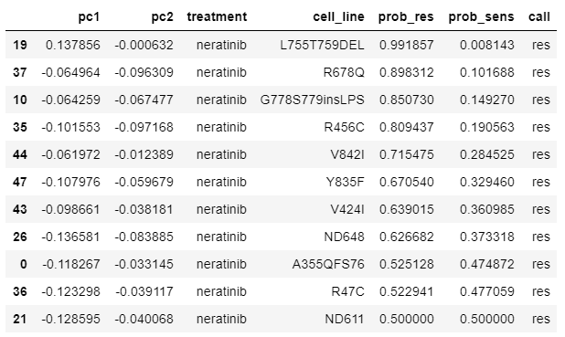
Resistant Calls
Sorted by probability (confidence)
From neratinib cluster proportion heatmap:

Slide 29
Sensitivity Experimental Setup
Grid Search
5 Replicates at each config. with random seeds
Config Params tested:
Clusters config: 2 3 5 10 15 25 35 45
Resampling size (time series length): 50 75 100 125 150
Data pre-processing: normalized or raw
Time < 8 hours. Overnight run.
For each experiment, random uuid assigned – output dir includes plots, classifier probability results and experiment results.

Slide 30
Sensitive/Resistant separability Training Accuracy
$$accuracy\left(train\right) \sim load+nclus+resample_sz$$
`normalized` had better accuracy
Higher number of clusters has better accuracy
Longer resample sizes have better accuracy
Variable | Coeficient | P-Value | Variable range
Intercept | 0.974441
load[T.raw] | -0.053883 | 1.289361e-26 | 0,1
nclus | 0.000462 | 4.042845e-03 | 2,45
resample_sz | 0.000098 | 1.416664e-01 | 50,150

Slide 31
Sensitive/Resistant separability Training Accuracy
$$accuracy\left(train\right) \sim load+nclus+resample_sz$$
`normalized` had better accuracy
Higher number of clusters has better accuracy
Longer resample sizes have better accuracy
Variable | Coeficient | P-Value | Variable range
Intercept | 0.974441
load[T.raw] | -0.053883 | 1.289361e-26 | 0,1
nclus | 0.000462 | 4.042845e-03 | 2,45
resample_sz | 0.000098 | 1.416664e-01 | 50,150

Slide 32
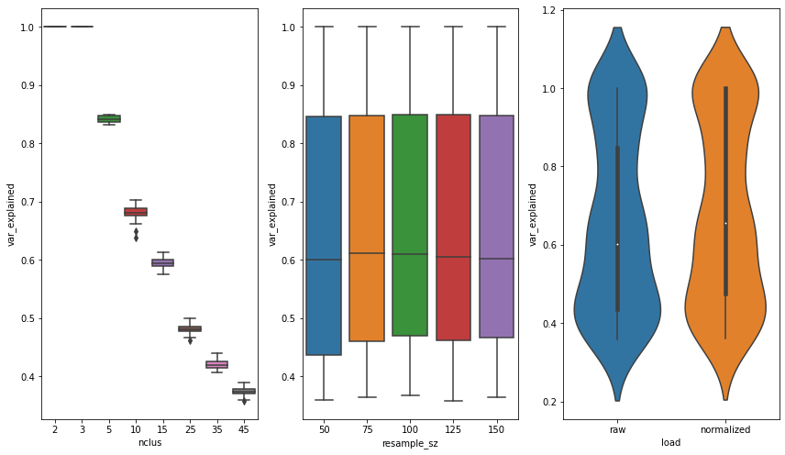
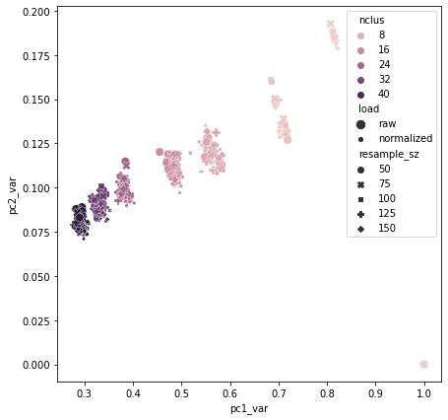
Dimensionality Reduction Explained variance

Slide 33
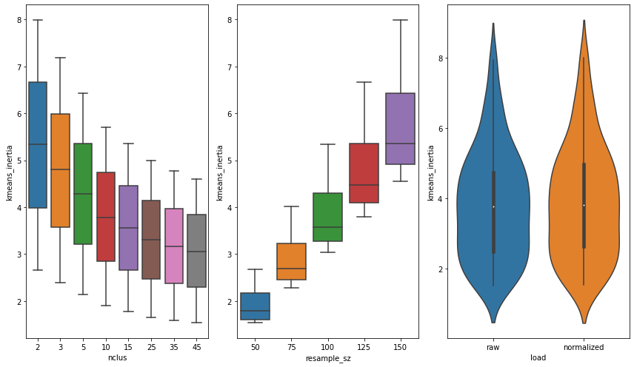
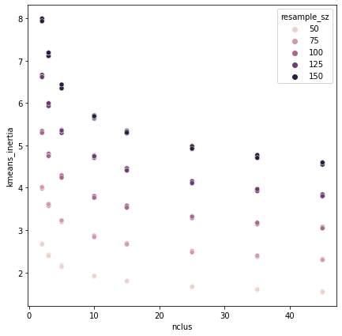
K-means Sum-of-squares (inertia)

Slide 34
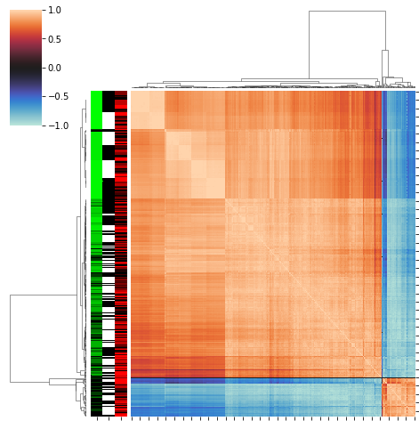
Probability Concordance
Pearson correlation between each experiment
Row label colors:
Green – nclusters (light green = few clusters)
White/balck – load (black = normalized)
Red – resample size (light red = shorter time series)

Slide 35
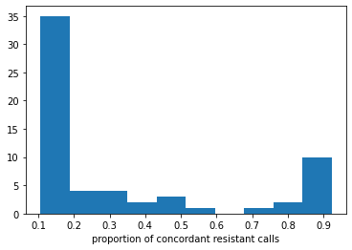
Call Concordance
7 cell lines have > 75% concordance of being called “resistant” (across ALL experiments)

Slide 36
Model Variance
Setup:
Filter to within replicates
Calculate pairwise Pearson corr.
Calculate sufficient statistics
Low-variance (stable) models would have perfect positive correlation
High-variance (instable) models would have high correlation variance and 0 or negative correlation.

Slide 37
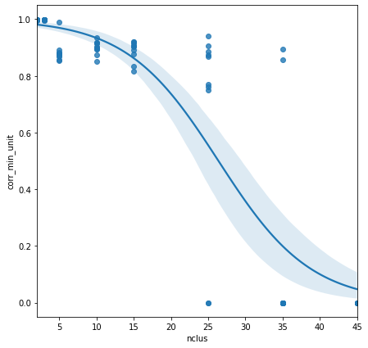
Model variance
Single-variate Logistic
$$corr_\min{\sim Logistic\left( nclus+load+resample sz\right)}$$
Variable | Coef. | CI (lower) | CI (upper) | Sig.
Intercept | 4.222236 | 1.429946 | 7.014527
load[T.raw] | -0.420407 | -1.919332 | 1.078518
nclus | -0.162454 | -0.229108 | -0.095800 | *
resample_sz | sz 0.002738 | -0.018269 | 0.023746

Slide 38
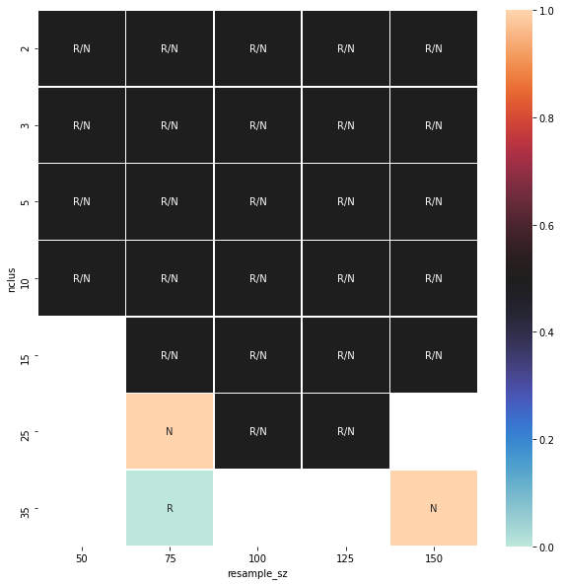
Stable Config. Parameters
config parameters with min_corr > 0.85
High number of clusters become unstable
‘raw’ seems to be slightly more stable

Slide 39
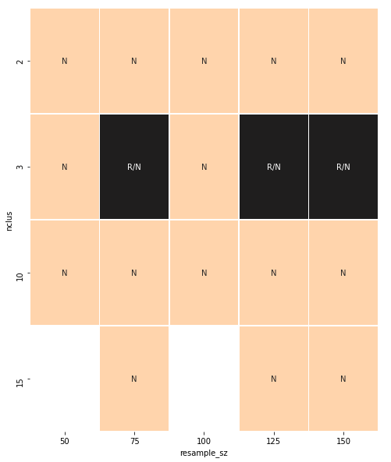
Configs with mean Accuracy == 1
Stable Configs

Slide 40
Recommended Config.
Resample size = 125
# clusters = 10
Pre-processing = ‘normalized’

Slide 41
Data Analysis Plan
Train/make calls within cell line & drug:
SKBR3 Neratinib
SKBR3 Trastuzumab
EFM192A Neratinib
EFM192A Trastuzumab
For each:
Identify stable hyperparam. configuration using sensitivity analysis
Run pipeline
Rank mutants by probability of being resistant + 0.5 probability cutoff
Samuel to select top X for validation
Incucyte (growth + death)
MCF10A live cell reporter imaging
???

